Slide 1
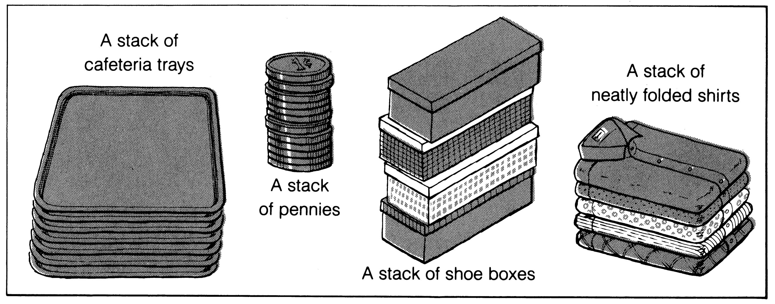
What is a stack?
It is an ordered group of homogeneous items of elements.
Elements are added to and removed from the top of the stack (the most recently added items are at the top of the stack).
The last element to be added is the first to be removed (LIFO: Last In, First Out).

Slide 2
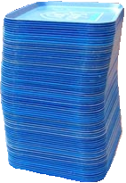
Stacks
stack: A collection based on the principle of adding elements and retrieving them in the opposite order.
  Last-In, First-Out ("LIFO")
  Elements are stored in order of insertion.
    We do not think of them as having indexes.
  Client can only add/remove/examine
  the last element added (the "top").
basic stack operations:
  push: Add an element to the top.
  pop: Remove the top element.
  peek: Examine the top element.
push
pop, peek
top | 3
 | 2
bottom | 1
stack
Notes:
analogy: trays of food at the sizzler

Slide 3
Recall: Java's Stack class
  Stack<Integer> s = new Stack<Integer>();
  s.push(42);
  s.push(-3);
  s.push(17); // [42, -3, 17] top
  System.out.println(s.pop()); // 17
  Stack does not use an ADT interface; it is poorly designed.
  If we were to re-implement Stack properly, how would it look?
Stack<E>() | constructs a new stack with elements of type E
push(value) | places given value on top of stack
pop() | removes top value from stack and returns it; throws EmptyStackException if stack is empty
peek() | returns top value from stack without removing it; throws EmptyStackException if stack is empty
size() | returns number of elements in stack
isEmpty() | returns true if stack has no elements

Slide 4
Int Stack ADT interface
Let's write our own implementation of a stack.
  To simplify the problem, we only store ints in our stack for now.
  As is (usually) done in the Java Collection Framework, we will define stacks as an ADT by creating a stack interface.
  public interface IntStack {
  void clear();
  boolean isEmpty();
  int peek();
  int pop();
  void push(int value);
  int size();
  }

Slide 5
Implementing with array
  public class ArrayIntStack implements IntStack {
  private int[] elements;
  private int size;
  ...
  }
A stack can be implemented efficiently with an unfilled array.
  An array plus a size field to remember the indexes used.
  s.push(26); // client code
  s.push(-9);
  s.push(14);
index | 0 | 1 | 2 | 3 | 4 | 5 | 6 | 7 | 8 | 9
value | 26 | -9 | 14 | 0 | 0 | 0 | 0 | 0 | 0 | 0
size | 3

Slide 6
Implementing push
How do we push an element onto the end of a stack?
public void push(int value) { // just put the element
elements[size] = value; // in the last slot,
size++; // and increase size
}
  s.push(42); // client code
index | 0 | 1 | 2 | 3 | 4 | 5 | 6 | 7 | 8 | 9
value | 3 | 8 | 9 | 7 | 5 | 12 | 0 | 0 | 0 | 0
size | 6
index | 0 | 1 | 2 | 3 | 4 | 5 | 6 | 7 | 8 | 9
value | 3 | 8 | 9 | 7 | 5 | 12 | 42 | 0 | 0 | 0
size | 7

Slide 7
Running out of space
What to do if client needs to add more than 10 elements?
  s.push(15); // add an 11th element
Resize the array if necessary:
  public void push(int value) {
  if (size == elements.length) {
  elements = Arrays.copyOf(elements, 2*size);
  }
  elements[size] = value;
  size++;
  }
index | 0 | 1 | 2 | 3 | 4 | 5 | 6 | 7 | 8 | 9
value | 3 | 8 | 9 | 7 | 5 | 12 | 4 | 8 | 1 | 6
size | 10

Slide 8
The Arrays class
Class Arrays in java.util has many useful array methods:
  Syntax: Arrays.methodName(parameters)
Method name | Description
binarySearch(array, value) or (array, start, end, value) | returns the index of the given value in a sorted array (or < 0 if not found)
copyOf(array, length) | returns a new resized copy of an array
equals(array1, array2) | returns true if the two arrays contain same elements in the same order
fill(array, value) | sets every element to the given value
sort(array) | arranges the elements into sorted order
toString(array) | returns a string representing the array, such as "[10, 30, -25, 17]"

Slide 9
Implementing pop
How do we pop an element off the end of a stack?
public int pop() {
int top = elements[size - 1];
elements[size - 1] = 0; // remove last element
size--; // and decrease size
return top;
}
  s.pop(); // client code; returns 12
index | 0 | 1 | 2 | 3 | 4 | 5 | 6 | 7 | 8 | 9
value | 3 | 8 | 9 | 7 | 5 | 12 | 0 | 0 | 0 | 0
size | 6
index | 0 | 1 | 2 | 3 | 4 | 5 | 6 | 7 | 8 | 9
value | 3 | 8 | 9 | 7 | 5 | 0 | 0 | 0 | 0 | 0
size | 5

Slide 10
Popping an empy stack
What if the client tries to pop from an empty stack?
  IntStack s = new ArrayIntStack();
  s.pop(); // client code
  What "should" happen?
  What is the right action for the stack to take in this case?
  What do Java's collections do in cases like this one?
index | 0 | 1 | 2 | 3 | 4 | 5 | 6 | 7 | 8 | 9
value | 0 | 0 | 0 | 0 | 0 | 0 | 0 | 0 | 0 | 0
size | 0

Slide 11
Other methods
Let's implement the following methods in our stack class:
  peek()
  Returns the element on top of the stack, without removing it.
  size()
  Returns the number of elements in the stack.
  isEmpty()
  Returns true if the stack contains no elements; else false.
  (Why write this if we already have the size method?)
  clear()
  Removes all elements from the stack.
  toString()
  Returns a string representation of the stack's elements.

Slide 12
Type parameters (generics)
List<Type> name = new ArrayList<Type>();
Recall: When constructing Java collections, you specify the type of elements it will contain between < and >.
  We say that the List accepts a type parameter,
  or that it is a generic class.
  List<String> names = new ArrayList<String>();
  names.add("Marty Stepp");
  names.add("Stuart Reges");
  List<Integer> scores = new ArrayList<Integer>();
  scores.add(17);
  scores.add(12);

Slide 13
Generic type limitations
  public class Foo<T> {
  private T myField; // ok
  public void method1(T param) {
  myField = param; // ok
  T temp = new T(); // error
  T[] array = new T[10]; // error
  }
  }
If my class accepts type parameter T, what is a T? What can a T do?
  Essentially nothing; think of a T as just any general Object.
  You can create variables, fields, parameters, and returns of type T.
  Can't call any type-specific methods on it, like length, toUpperCase, sort...
  Can't construct a new object of type T.
  Can't directly construct a new array of T objects (T[]).
    (But a work-around is to construct a new Object[] and cast to T[]...)

